Slide 1
Parameter estimation class 5
Multiple View Geometry
Comp 290-089
Marc Pollefeys

Slide 2
Content
Background: Projective geometry (2D, 3D), Parameter estimation, Algorithm evaluation.
Single View: Camera model, Calibration, Single View Geometry.
Two Views: Epipolar Geometry, 3D reconstruction, Computing F, Computing structure, Plane and homographies.
Three Views: Trifocal Tensor, Computing T.
More Views: N-Linearities, Multiple view reconstruction, Bundle adjustment, auto-calibration, Dynamic SfM, Cheirality, Duality

Slide 3
Multiple View Geometry course schedule
(subject to change)
Jan. 7, 9 | Intro & motivation | Projective 2D Geometry
Jan. 14, 16 | (no class) | Projective 2D Geometry
Jan. 21, 23 | Projective 3D Geometry | (no class)
Jan. 28, 30 | Parameter Estimation | Parameter Estimation
Feb. 4, 6 | Algorithm Evaluation | Camera Models
Feb. 11, 13 | Camera Calibration | Single View Geometry
Feb. 18, 20 | Epipolar Geometry | 3D reconstruction
Feb. 25, 27 | Fund. Matrix Comp. | Structure Comp.
Mar. 4, 6 | Planes & Homographies | Trifocal Tensor
Mar. 18, 20 | Three View Reconstruction | Multiple View Geometry
Mar. 25, 27 | MultipleView Reconstruction | Bundle adjustment
Apr. 1, 3 | Auto-Calibration | Papers
Apr. 8, 10 | Dynamic SfM | Papers
Apr. 15, 17 | Cheirality | Papers
Apr. 22, 24 | Duality | Project Demos

Slide 4
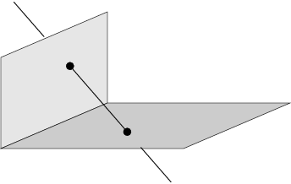
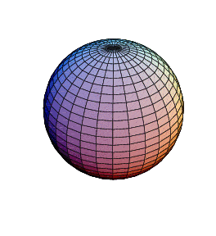
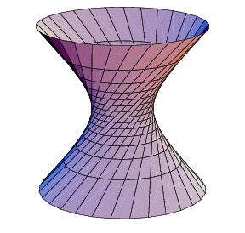
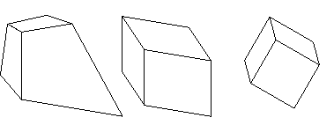
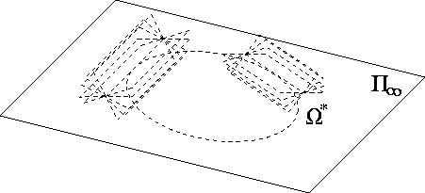
Projective 3D Geometry
Points, lines, planes and quadrics
Transformations
П∞, ω∞ and Ω ∞

Slide 5
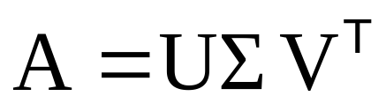




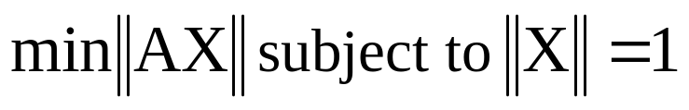
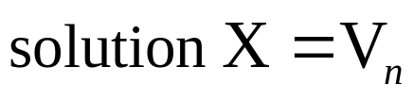
Singular Value Decomposition
Homogeneous least-squares

Slide 6
Parameter estimation
2D homography
  Given a set of (x_{i},x_{i}’), compute H (x_{i}’=Hx_{i})
3D to 2D camera projection
  Given a set of (X_{i},x_{i}), compute P (x_{i}=PX_{i})
Fundamental matrix
  Given a set of (x_{i},x_{i}’), compute F (x_{i}’^{T}Fx_{i}=0)
Trifocal tensor
  Given a set of (x_{i},x_{i}’,x_{i}”), compute T

Slide 7
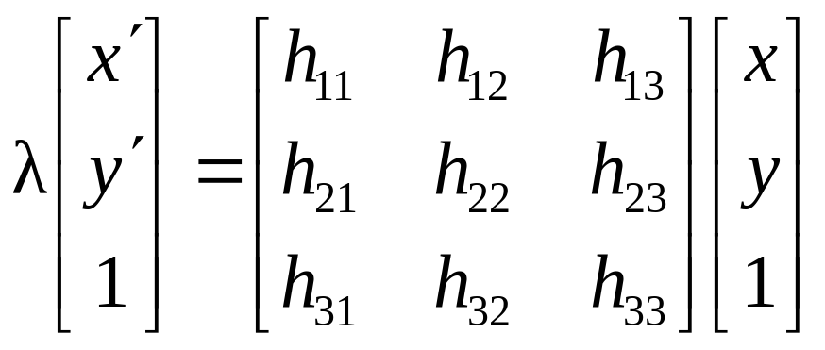
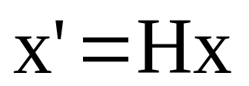
Number of measurements required
At least as many independent equations as degrees of freedom required
Example:
2 independent equations / point
8 degrees of freedom
4x2≥8

Slide 8
Approximate solutions
Minimal solution
  4 points yield an exact solution for H
More points
  No exact solution, because measurements are inexact (“noise”)
  Search for “best” according to some cost function
  Algebraic or geometric/statistical cost
Notes:
Exact solutions are important for robust approaches

Slide 9
Gold Standard algorithm
Cost function that is optimal for some assumptions
Computational algorithm that minimizes it is called “Gold Standard” algorithm
Other algorithms can then be compared to it
Notes:
Other algorithms can have other advantages: faster, more reliable, etc.

Slide 10
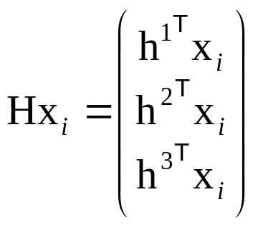
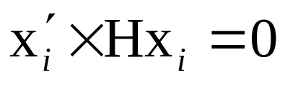
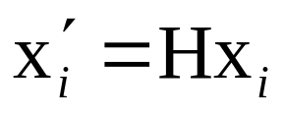
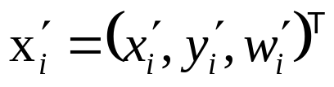
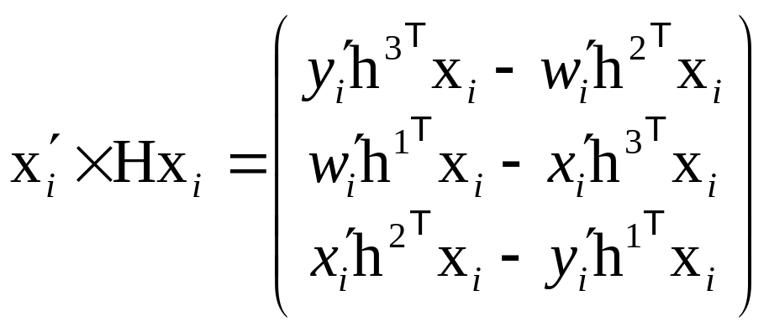
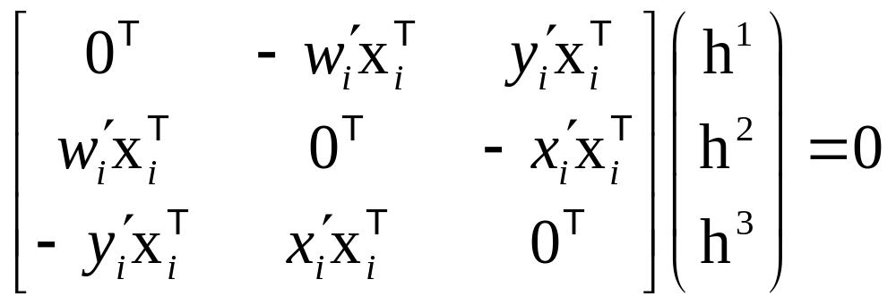
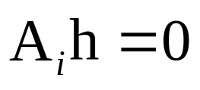
Direct Linear Transformation
(DLT)

Slide 11
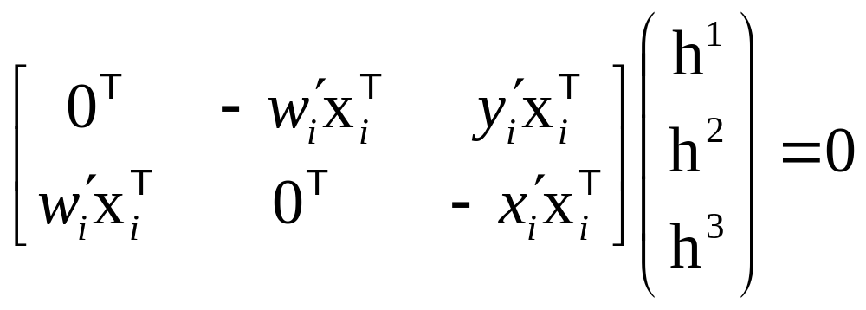
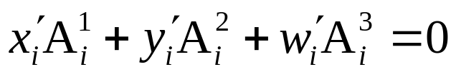
Direct Linear Transformation
(DLT)
Equations are linear in h
Only 2 out of 3 are linearly independent
(indeed, 2 eq/pt)
(only drop third row if w_{i}’≠0)
Holds for any homogeneous representation, e.g. (x_{i}’,y_{i}’,1)
Notes:
row 3 = x.(row 1)+y.(row 2)

Slide 12
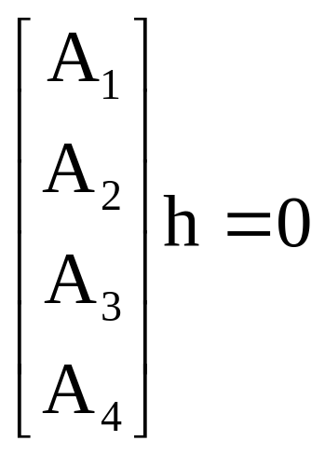

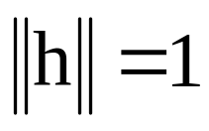
Direct Linear Transformation
(DLT)
Solving for H
size A is 8x9 or 12x9, but rank 8
Trivial solution is h=0₉^{T} is not interesting
1-D null-space yields solution of interest
pick for example the one with

Slide 13
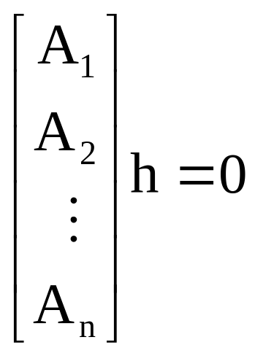


Direct Linear Transformation
(DLT)
Over-determined solution
No exact solution because of inexact measurement
i.e. “noise”
Find approximate solution
Additional constraint needed to avoid 0, e.g.
not possible, so minimize

Slide 14
DLT algorithm
Objective
Given n≥4 2D to 2D point correspondences {x_{i}↔x_{i}’}, determine the 2D homography matrix H such that x_{i}’=Hx_{i}
Algorithm
For each correspondence x_{i} ↔x_{i}’ compute A_{i}. Usually only two first rows needed.
Assemble n 2x9 matrices A_{i} into a single 2nx9 matrix A
Obtain SVD of A. Solution for h is last column of V
Determine H from h

Slide 15

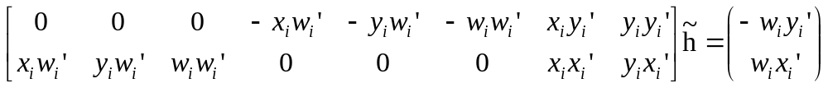
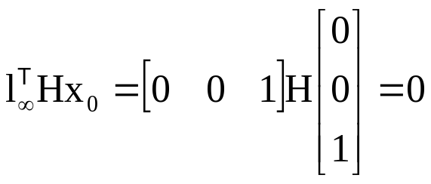
Inhomogeneous solution
Since h can only be computed up to scale, pick h_{j}=1, e.g. h₉=1, and solve for 8-vector
Solve using Gaussian elimination (4 points) or using linear least-squares (more than 4 points)
However, if h₉=0 this approach fails
also poor results if h₉ close to zero
Therefore, not recommended
Note h₉=H₃₃=0 if origin is mapped to infinity

Slide 16




Degenerate configurations
x₁
x₁
x₁
x₄
x₄
x₂
H?
H’?
x₄
x₂
x₂
x₃
x₃
x₃
(case A)
(case B)
Constraints:
i=1,2,3,4
Define:
Then,
H* is rank-1 matrix and thus not a homography
If H* is unique solution, then no homography mapping x_{i}→x_{i}’(case B)
If further solution H exist, then also αH*+βH (case A)
(2-D null-space in stead of 1-D null-space)

Slide 17
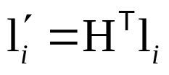

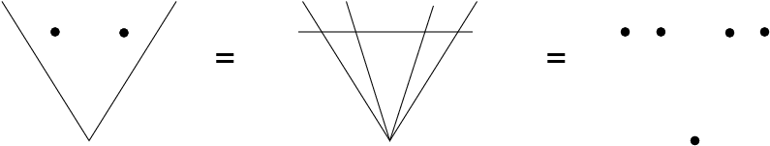
Solutions from lines, etc.
2D homographies from 2D lines
Minimum of 4 lines
3D Homographies (15 dof)
Minimum of 5 points or 5 planes
2D affinities (6 dof)
Minimum of 3 points or lines
Conic provides 5 constraints
Mixed configurations?

Slide 18
Cost functions
Algebraic distance
Geometric distance
Reprojection error
Comparison
Geometric interpretation
Sampson error

Slide 19


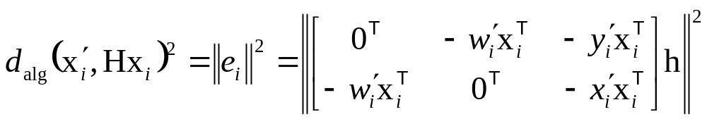
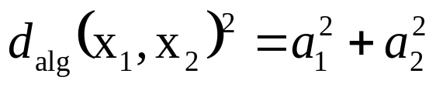
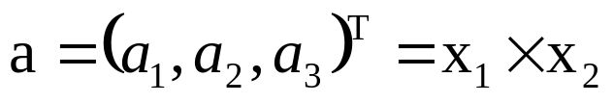
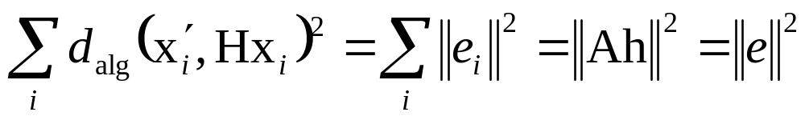
Algebraic distance
DLT minimizes
residual vector
partial vector for each (x_{i}↔x_{i}’)
algebraic error vector
algebraic distance
where
Not geometrically/statistically meaningfull, but given good normalization it works fine and is very fast (use for initialization)

Slide 20



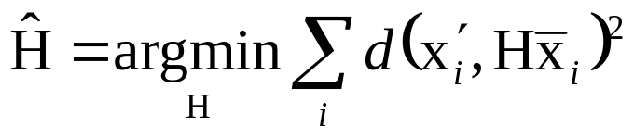
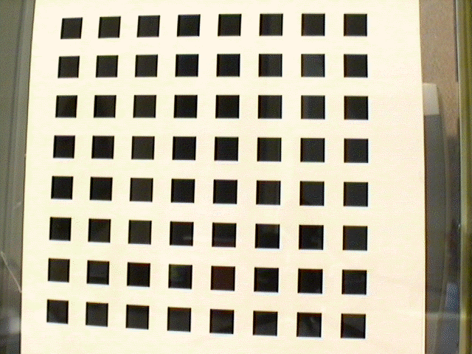
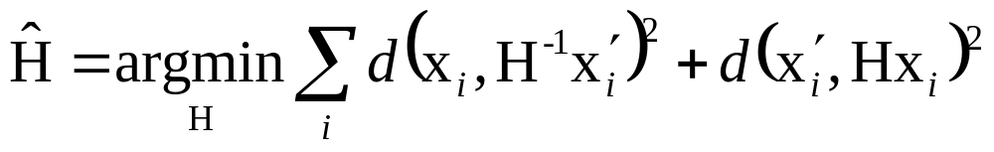
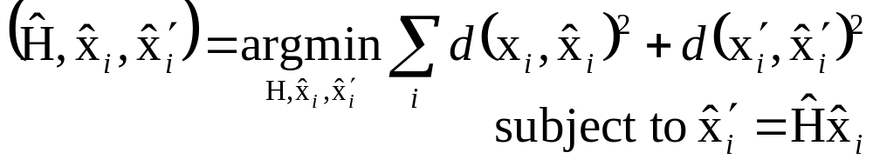
Geometric distance
measured coordinates
estimated coordinates
true coordinates
d(.,.) Euclidean distance (in image)
Error in one image
e.g. calibration pattern
Symmetric transfer error
Reprojection error

Slide 21
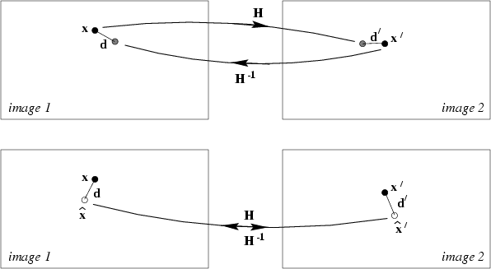
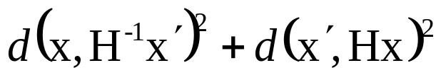
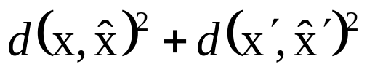
Reprojection error

Slide 22

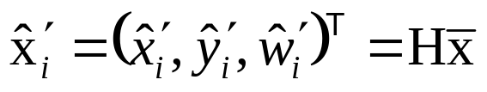
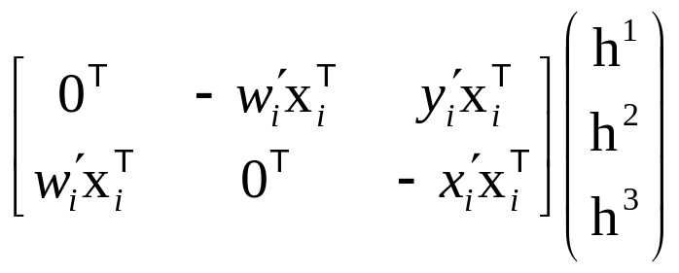
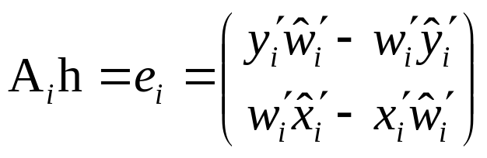
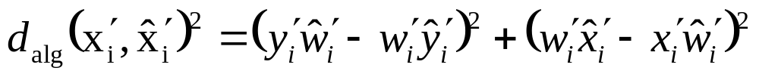
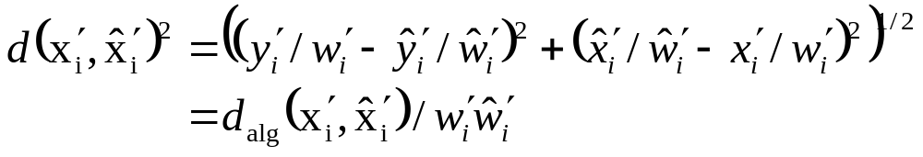


Comparison of geometric and algebraic distances
Error in one image
typical, but not , except for affinities
For affinities DLT can minimize geometric distance
Possibility for iterative algorithm

Slide 23


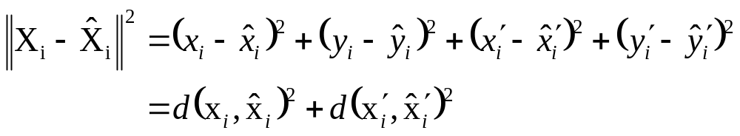

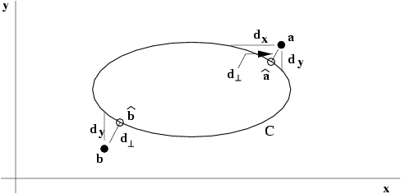


Geometric interpretation of reprojection error
Estimating homography~fit surface to points X=(x,y,x’,y’)^{T} in ⁴
represents 2 quadrics in ⁴ (quadratic in X)
Analog to conic fitting
Notes:
Nonlinear, except for line fitting = affine homographies (no quadratic terms in this case!) (x,x’,y and x,y,y’) => linear solution

Slide 24
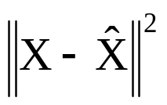




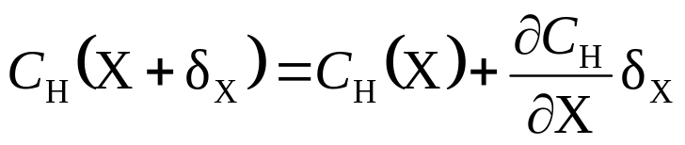


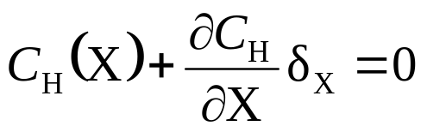
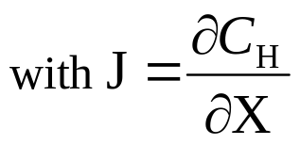



Sampson error
between algebraic and geometric error
Vector that minimizes the geometric error is the closest point on the variety to the measurement
Sampson error: 1st order approximation of
Find the vector that minimizes subject to

Slide 25





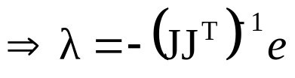
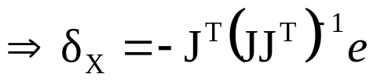


Find the vector that minimizes subject to
Use Lagrange multipliers:
minimize
derivatives

Slide 26
Sampson error
between algebraic and geometric error
Vector that minimizes the geometric error is the closest point on the variety to the measurement
Sampson error: 1st order approximation of
Find the vector that minimizes subject to
(Sampson error)

Slide 27






Sampson approximation
A few points
For a 2D homography X=(x,y,x’,y’)
is the algebraic error vector
is a 2x4 matrix, e.g.
Similar to algebraic error in fact, same as Mahalanobis distance
Sampson error independent of linear reparametrization (cancels out in between e and J)
Must be summed for all points
Close to geometric error, but much fewer unknowns

Slide 28




Statistical cost function and Maximum Likelihood Estimation
Optimal cost function related to noise model
Assume zero-mean isotropic Gaussian noise (assume outliers removed)
Error in one image
Maximum Likelihood Estimate

Slide 29


Statistical cost function and Maximum Likelihood Estimation
Optimal cost function related to noise model
Assume zero-mean isotropic Gaussian noise (assume outliers removed)
Error in both images
Maximum Likelihood Estimate

Slide 30



Mahalanobis distance
General Gaussian case
Measurement X with covariance matrix Σ
Error in two images (independent)
Varying covariances

Slide 31






Next class:
Parameter estimation (continued)
Transformation invariance
and normalization
Iterative minimization
Robust estimation

Slide 32

Upcoming assignment
Take two or more photographs taken from a single viewpoint
Compute panorama
Use different measures DLT, MLE
Use Matlab
Due Feb. 13

